Slide 1
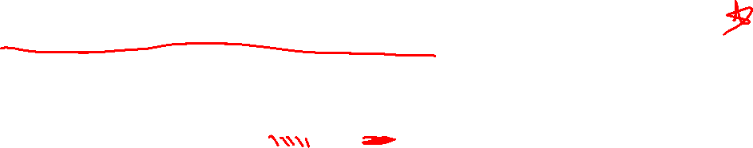
Section 3.1 Quadratic Functions and Models
Lecture 1
New and old ideas
Notes:
Note, skip 2.5, more on lines, focus is on thinking linear. Similar ideas to previous lectures

Slide 2

Homework Submission to Canvas
Preview of section
Skim the section in text and write a short paragraph summary.
Give a bulleted list of all important definitions, theorems, and formulas without details.
Notes on video lectures
Take notes on everything written on slides including all details, worked examples, on-own activities, as well as your own thoughts and questions.
Try on-own activities first, then write down provided solution next to it for comparison.
Worked examples from the text
Write down the problem and attempt without looking at the solution.
Use the solution to write the best explanation you can.
Solutions to textbook exercises
Model approaches and explanations given in the video lectures and textbook examples.
Final reflection of section
List the key takeaways to remember as a bulleted list.

Slide 3
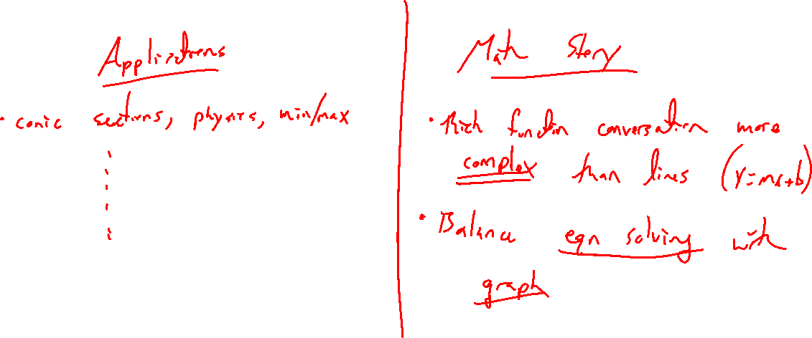
Why Quadratic Functions?
Notes:
Applications: https://en.wikipedia.org/wiki/ Parabola, death ray, etc
Math theory:
- Rich example compared to lines
- Views: Solve equations, graph
- 2 main forms

Slide 4
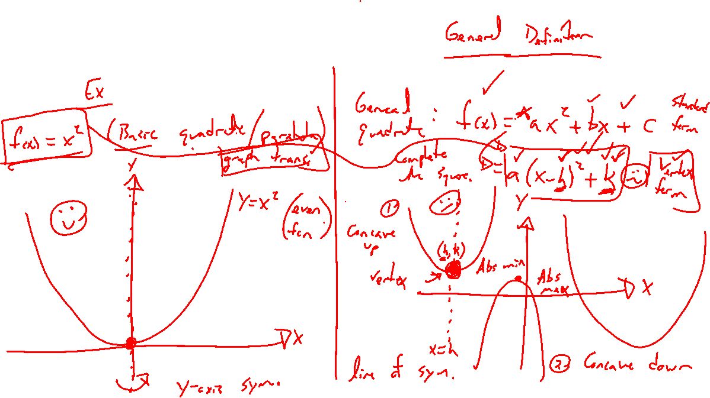
Quadratic Function
Notes:
Definition: Standard form, vertex form
Connect to what we know
Vertex, axis of symmetry (max/min), concave up / down

Slide 5

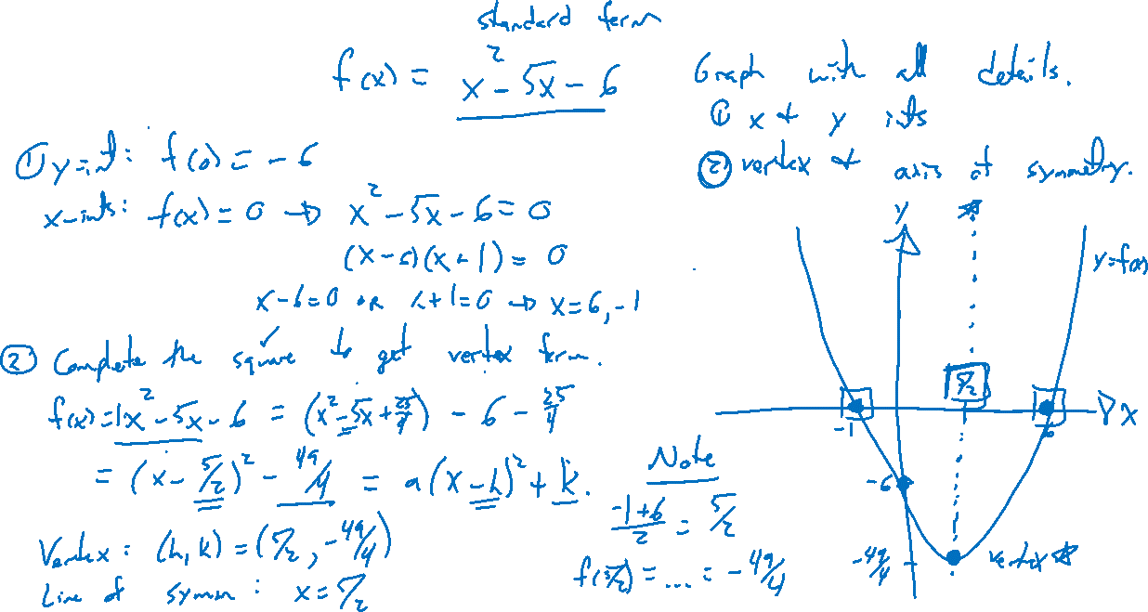
Example:
Notes:
F(x) = x^2-5x-6
Graph and label details
Complete the square to vertex form

Slide 6

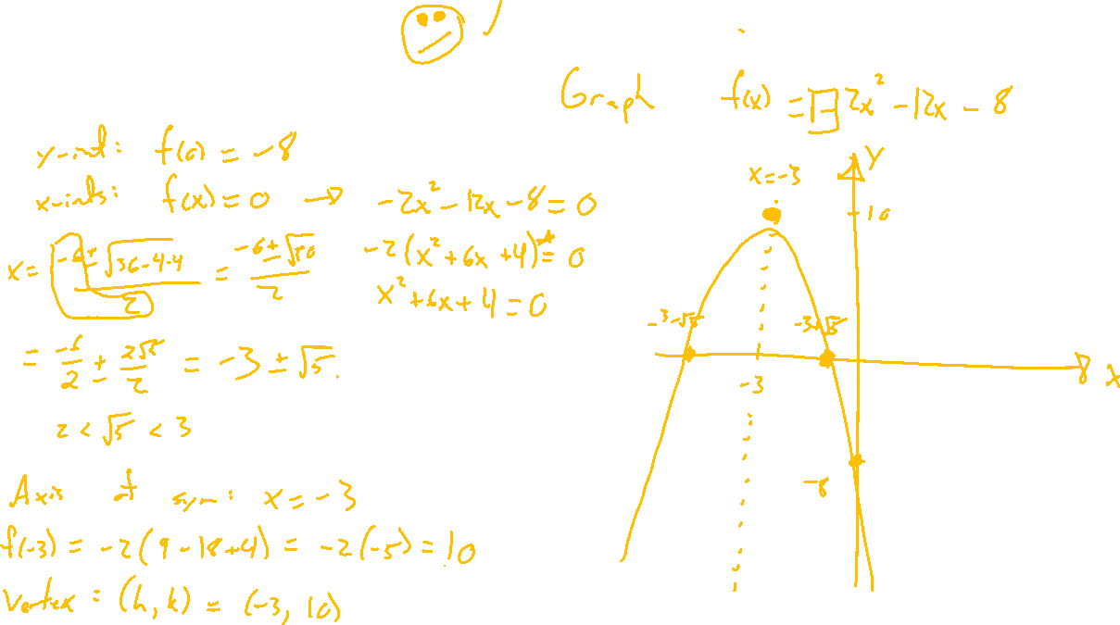
Example: Try on Own
Notes:
F(x) = -2x^2-12x-8

Slide 7
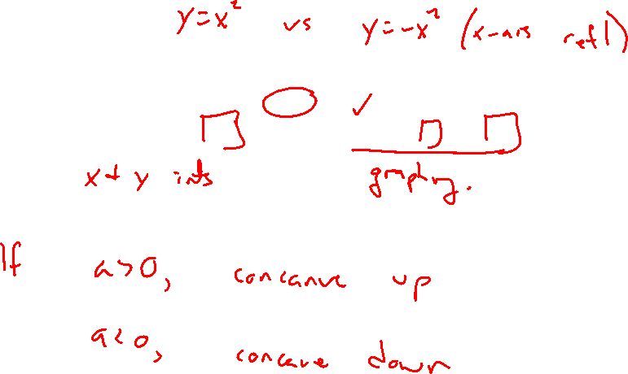
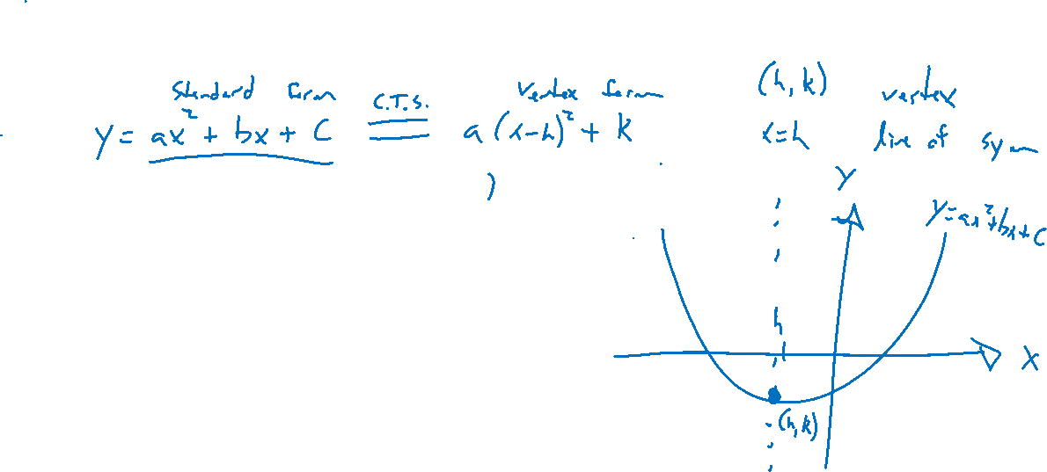
Quadratic Function Summary
Notes:
Recap main ideas. Hint at applications with max / min values.

